Slide 1
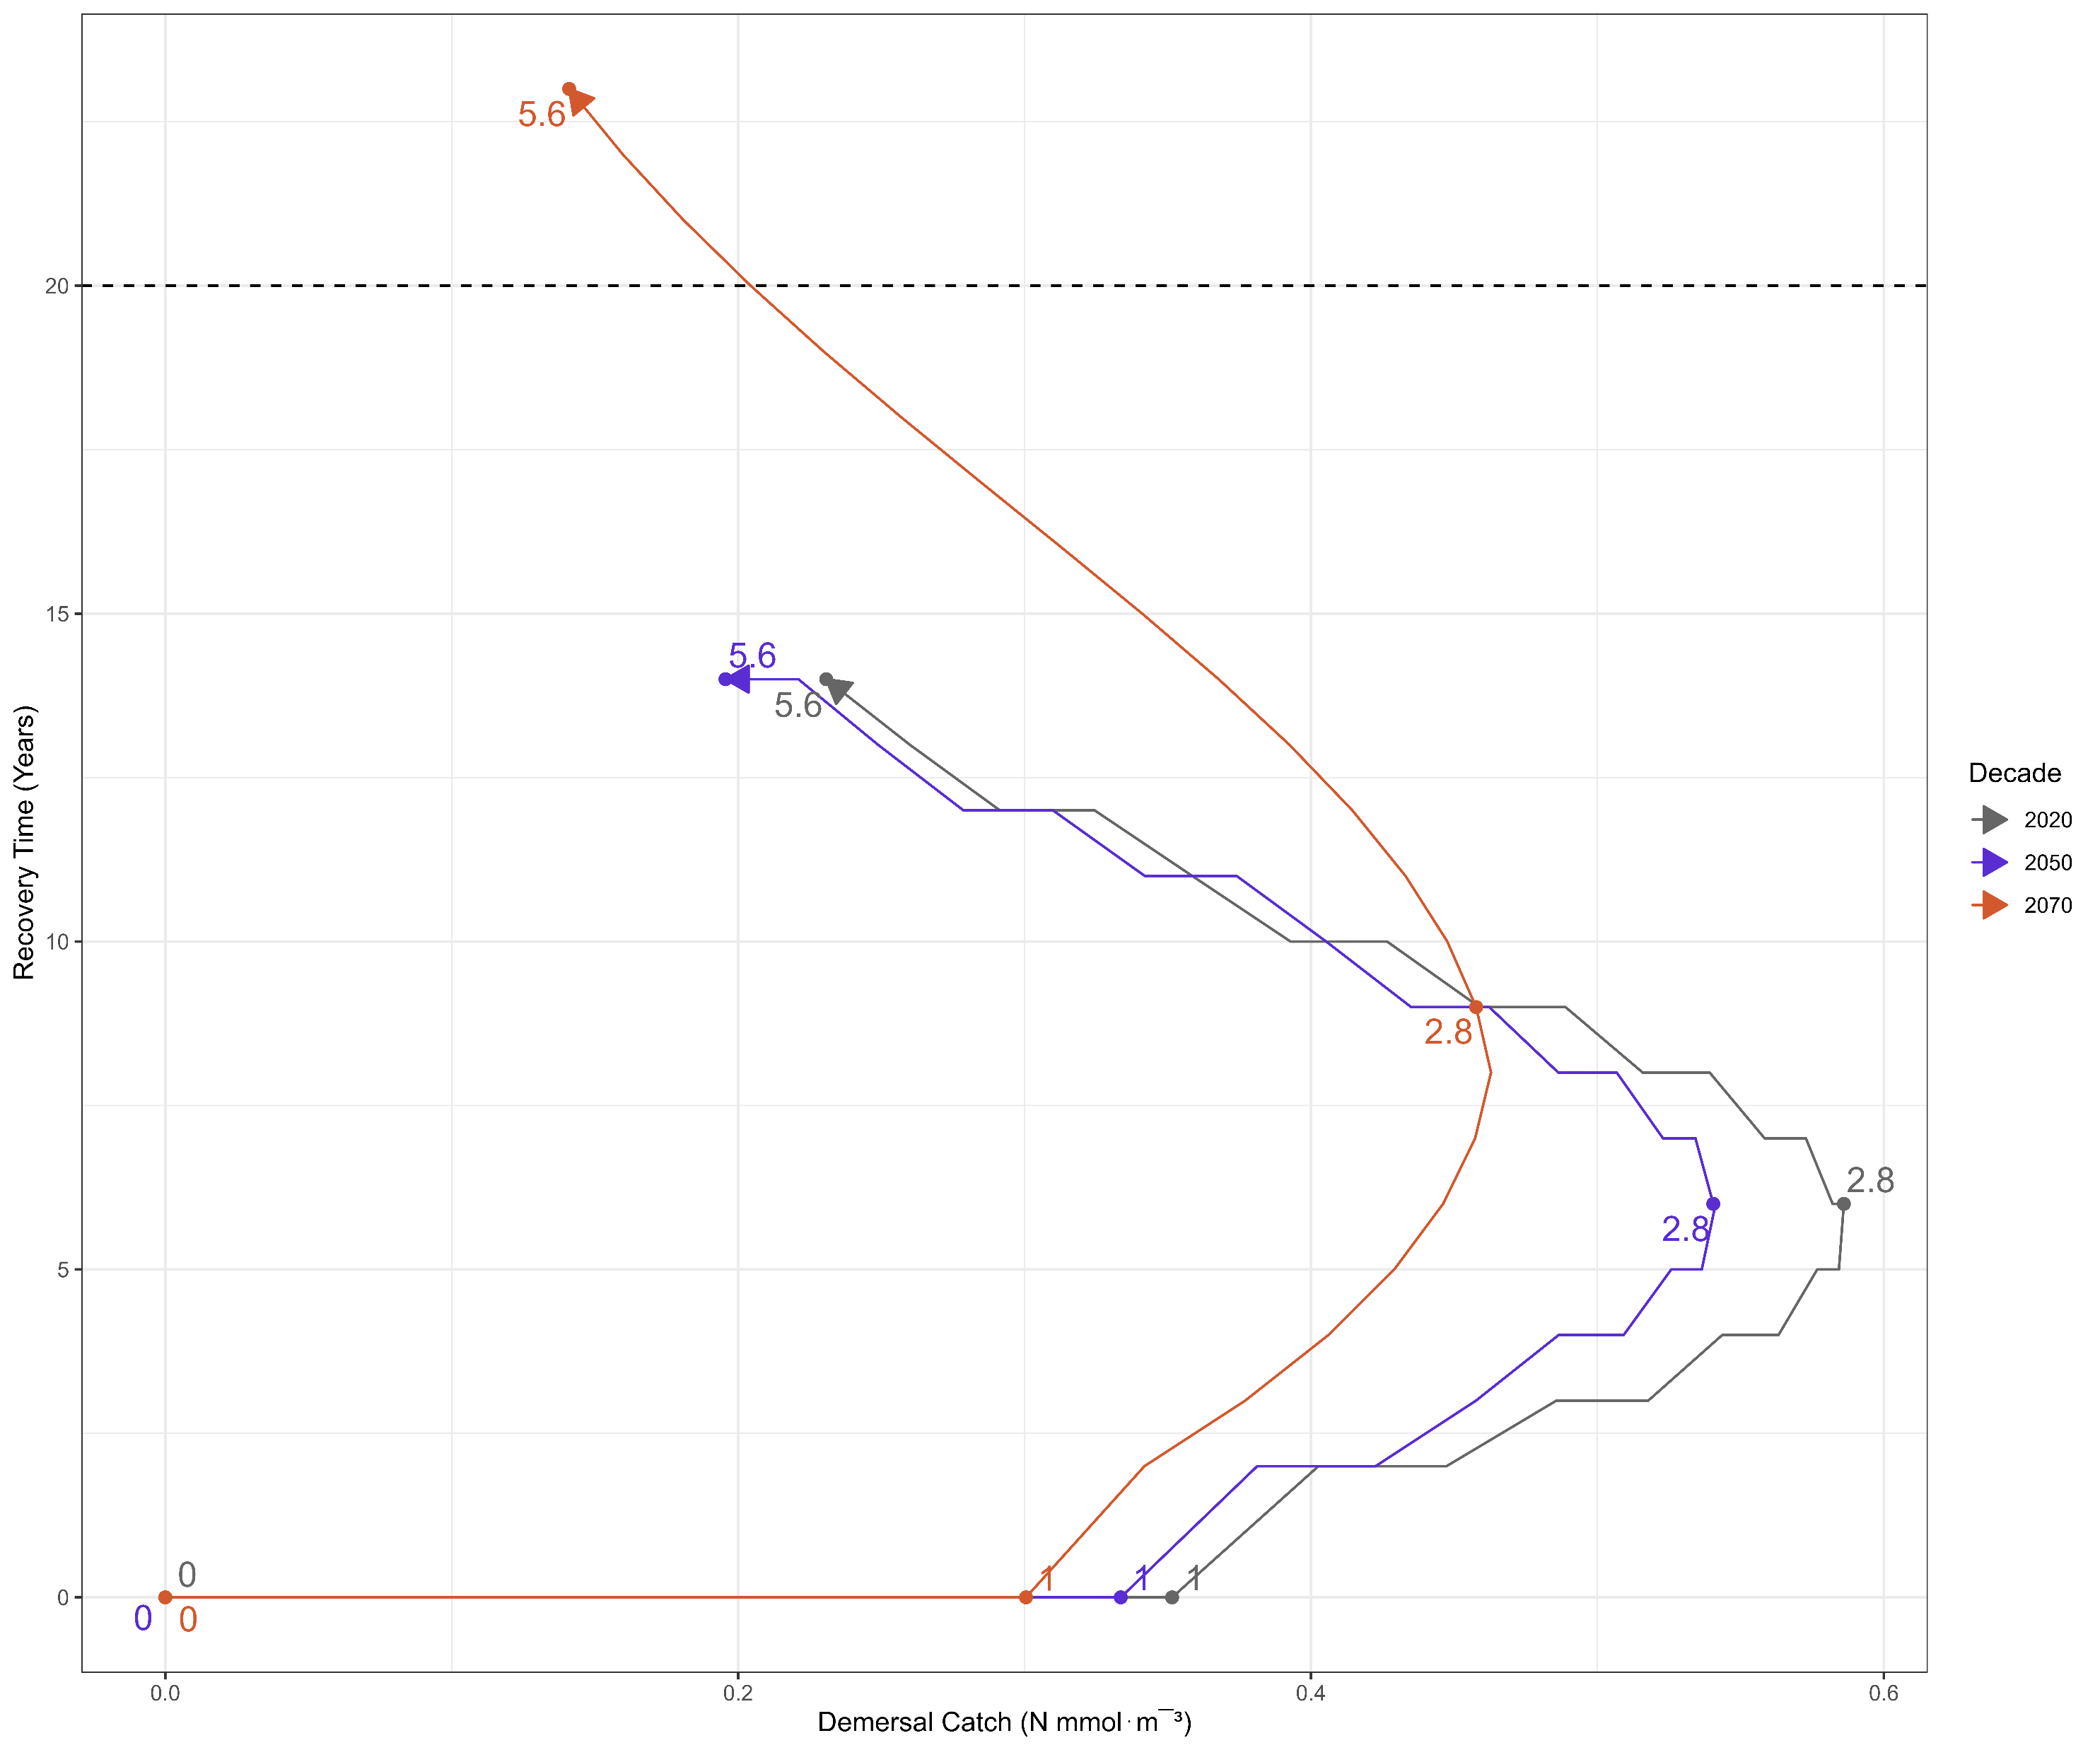
No Benefit
Increased Harvest +
Recovery Time
Decreased Harvest
Increased Ecosystem Health

